Slide 1
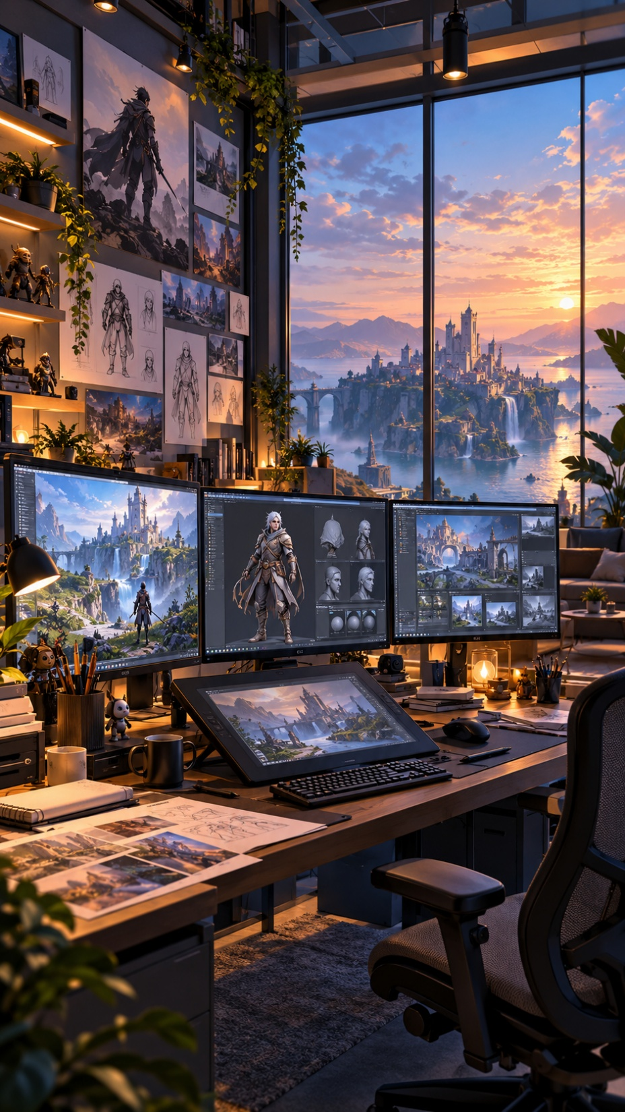

CO1035: Game Concepts
Lecture 1B
The Commercial Games Development Industry

Slide 2
Objectives
Identify key players in the industry and their roles
Identify and Describe the different phases of commercial games development
Identify and Describe the roles in game development teams
This Lecture is separated into three parts:
  Part A: Introduction to Commercial Games Development
  Part B: Phases of Commercial Games Development
  Part C: Game Development Teams and Roles

Slide 3
Part A:
Introduction to Commercial
Games Development

Slide 4
Introduction
The commercial video games industry has been around since the 1970s
Nowadays, it is a global, multi-billion-dollar industry
Combines several aspects of other industries such as creativity, technology and business strategy
This industry includes key players such as developers/studios, publishers, console manufacturers and retailers.
All these involved parties share a common goal:
  The production of games that sell in huge quantities, for players on serval platforms, such as mobile, home consoles, handheld consoles, PCs, Web, VR Headsets etc.

Slide 5
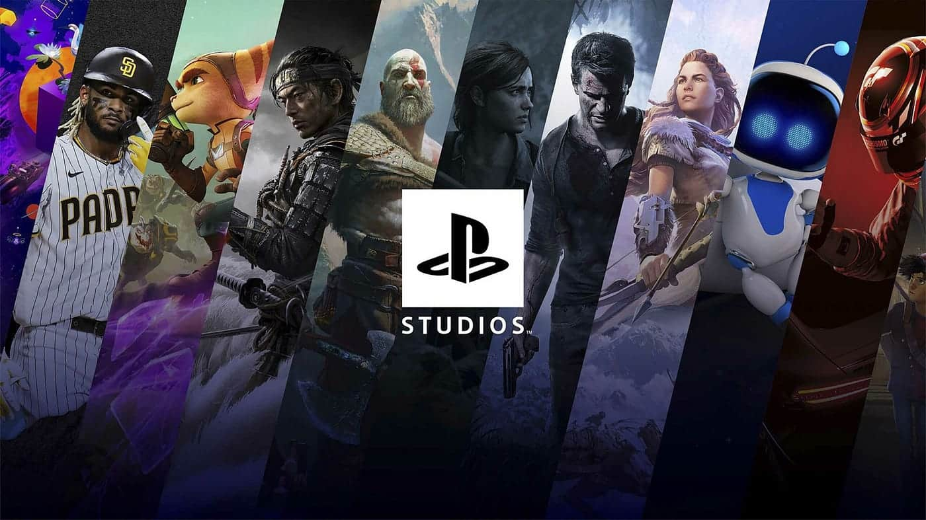

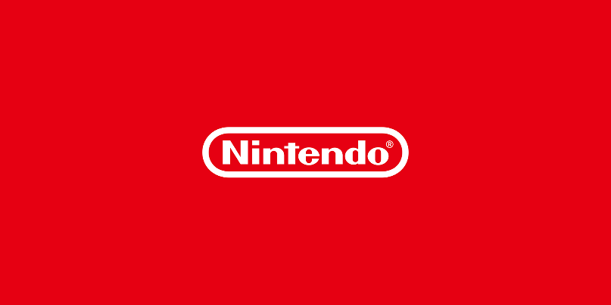
Players Involved: Game Manufacturers
What are they?
  Companies that design, produce and maintain gaming hardware planforms
  Provide the ecosystems where games are played
What is their role?
  Define technical standards and performance capabilities for games
  Offer development kits (SDKs) and publishing support to studios
  Operate digital marketplaces (e.g. PlayStation Store XBOX Store, etc)

Slide 6



Players Involved: Game Developers/Studios
The games industry isn’t one-size-fits-all and it includes many types of studios that differ in terms of scale, funding and creativity control.
AAA Studios: Large-scale studios with major funding and big teams. They focus on high production values and global releases (e.g., Riot Games – League of Legends).
AA Studios: Medium-scale studios with moderate budget (e.g. Krafton’s PUBG Studios – PUBG: Battlegrounds)
Indie Studios: Small, independent teams or solo developers. Minimal funding – typically self-funded
(e.g. Extremely OK Games – Tower Fall)
Outsourcing & Support Studios: Provide art, animation or other important services to other studios (e.g. Room 8 studio)

Slide 7



Players Involved: Publishers
What are they?
  Companies that fund, market and distribute game projects
  Act as the bridge between developers and the marketplace
  Can sometimes own game studios (e.g. Ubisoft, EA, Epic Games, Riot, Nintendo, Activision Blizzard, etc)
What is their role?
  Financing a game (provide money for production and marketing)
  Project Management (Oversee milestones and quality standards)
  Marketing (Promote the game to media)
  Sometimes handle Distribution (retail and logistics)

Slide 8


Players Involved - Retailers
Sometimes publishers are not handing the retail of their games and retailers are becoming responsible for that
What are they?
  Businesses that sell games directly to the consumers
  Can be physical stores (e.g. GameStop, Best Buy) or digital platforms (e.g. Stram, Nintendo eShop)
  Act as the final link in the commercial games supply chain
What is their role?
  Provide sales, promotion and discoverability for games
  Handle transactions, pre-orders and pricing
  Gather sales data and player trends which are valuable for future projects.

Slide 9
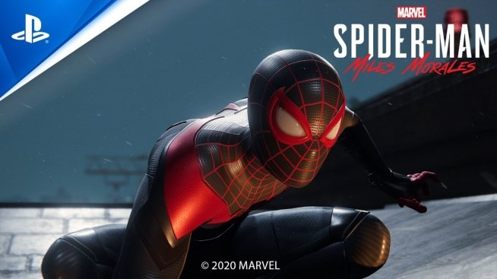
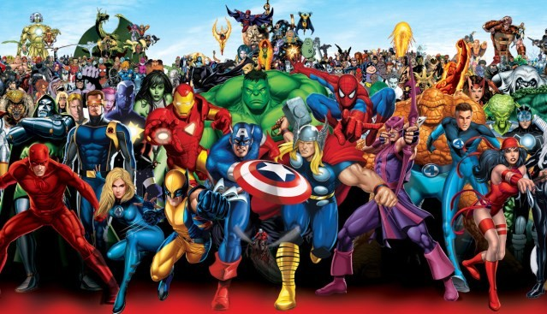


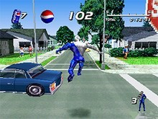
Players Involved - Others
Movie Studios
  Disney
  Marvel
  Universal Studios
  DreamWorks
People
  Celebrities
  Personalities
  Sports players
Products/Brands

Slide 10
Where do Game Ideas Come from?
Game ideas can come from anywhere
  A memory, a mechanic, a book, a film, a dream, a myth, pure imagination…
Many iconic games began with a simple question or an experiment:
  What if we let players build their own world? – Minecraft
  What if stealth was a mechanic? – Metal Gear Solid
Typically, an original concept can be created by a developer
However, it is also very common for a game concept to be inspired by business decisions:
  A publishing company deciding to make a sequel
  A publishing company making a deal with a movie studio (movie-based game)

Slide 11
The Game Development Process
A developer with a game concept tries to get a publisher to fund the development
OR
A publisher interested in developing a game and tries to get a developer
In either case, a publisher funds a developer to create a game
The publisher markets and distributes the finished game
The game is sold by retailers
Revenue is shared by all parties involved

Slide 12
The Game Development Process
However….. This is not always the case!
There are some cases where:
  A cash-rich development company can fund themselves
  A publisher can own a game studio and fund its own development team
  Console manufacturers sometimes act as publishers, and can own their own game studio(s)

Slide 13
PART B:
Phases of Commercial Games Development

Slide 14
Phases of Commercial Games Development
Most commercial game development projects are broken down into four phases:
Concept Phase
Pre-production Phase
Production Phase
Post-production Phase

Slide 15
Concept Phase
The phase were the game idea is conceptualized
The team agrees on the game’s mechanics, visual style, game play etc
The team produces a concept document that communicates the vison of the game.
  Answers to the main questions that will asked be asked by potential publishers.
If a publisher agrees to fund the development of the game, the project is green-lighted.
  To fund the game an important step is for the team to agree on “milestones” with the publisher
  Typically, in each milestone the developers submit the product to the publisher
  …and typically, the team is paid by the “milestones” reached.
If funding is secured, then the team proceeds to the Pre-Production phase

Slide 16
Pre-Production Phase
In this phase the Visual elements (e.g. look and feel), technical details (e.g. game engine), and story are specified.
A playable demo of the game is created to demonstrate the eventual game experience.
A game design document is produced to prepare for full scale production (more about
GDD in next week’s lecture)
Then, all the management of the development process, including hiring staff and assignment of roles and responsibilities, is specified.

Slide 17
Production Phase
In this phase the game design document is followed by the team, and the game is developed, in 2 phases (alpha and beta).
This phase usually takes about 50% of the entire project life-cycle.
Alpha Stage: The game reaches this stage when all its features and assets are in place, although some assets may not be in their final versions.
  In this stage, bugs are identified, and all final assets are added.
Beta Stage: The games goes to beta once all assets, objects, environments etc are completed and all bugs are fixed.
Following Beta, the game is opened up to players for testing, finding and fixing bugs, and game-play evaluation.
Finally, the Gold Master disc is created, sent for reproduction, and copies distributed to
retailers.

Slide 18
Post-Production Phase
Once a game is released, the post production phase begins.
This phase includes maintenance in the form of patches.
DLCs can also be introduced in the game in this phase.

Slide 19
Each Project Is Unique
PROJECT1
PROJECT 2
PROJECT 3
Game Concept
Concept Document
Secure Funding
Agree on Milestones
Playable Demo
Game Concept
Concept Document
Playable Demo
Game Concept
Concept Document
Secure Funding
Agree on Milestones
Playable Demo
Secure Funding
Agree on Milestones
Game Design Document
Hire Team
Game Design Document
Game Design Document
Hire Team
Hire Team
Start Development
First Playable (Alpha)
Beta
Testing
Marketing
Hype
Release
Start Development
First Playable (Alpha)
Beta
Testing
Start Development
First Playable (Alpha)
Beta
Testing
Marketing Hype
Release Patches Updates
DLCs
Marketing
Hype
Release
Patches
Patches
Updates
DLCs

Slide 20
PART C:
Game Development Teams
and Roles

Slide 21
The Development Team and Roles
Management
Typically, the development team is separated into four sub-groups:
  Management Group – responsible for managing the game progress
  Programmers – responsible for coding the game
  Artists – responsible for the art of the game
  Designers – responsible for gameplay
The size of a each development team can vary depending of the project size and the stage of development
Teams can have anywhere from 2 to 100 members.
Programmers
Artists
code
Designers
art
game play
GAME

Slide 22
Game Programmers
Game programmers are the people responsible for implementing the mechanics and logic to the game.
To implement games, they use game specific tools and API’s (Application Programmer Interfaces), e.g. DirectX, Unity or Unreal Engine.
  TL-Engine is an example of a games API.
…and to code the game they usually use C++, C# and other scripting languages (Lua and python) using a standard development environment like Microsoft Visual Studio.
With that said...
Don’t consider games development as a different process from the development of other programs and software.
Although it is more creative, at its core it is an ordinary software engineering discipline.

Slide 23

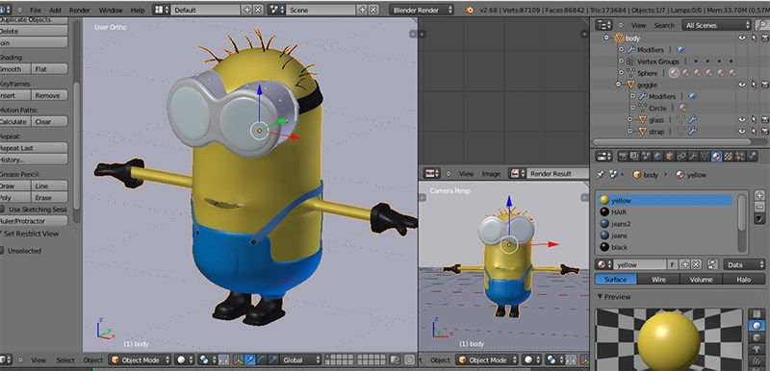
Game Artists
Game Artists are the people responsible for implementing the models and the art of the game.
Game artists
  Realize the concept illustrations using 3D modelling tools (e.g. Blender, or Maya).
  Create animations for the characters and objects in the game.
  And create 2D graphics if necessary.
However,
  3D modelling tools can also leverage programming, using “scripts".
  Scripts are used to help "export" models into game engines, and also create complex animations.

Slide 24
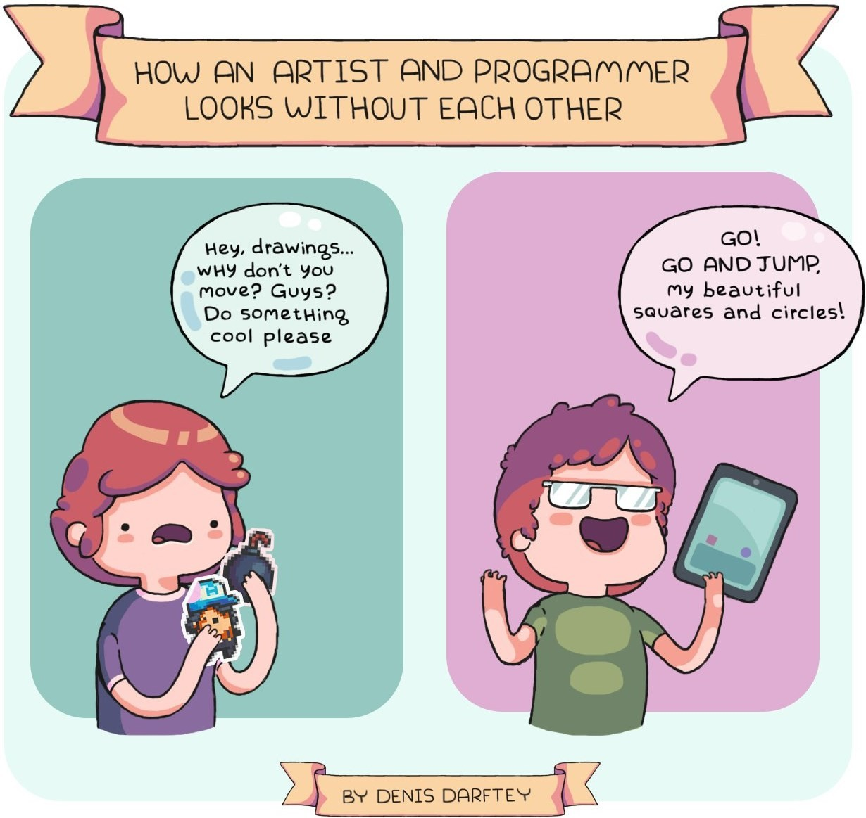
Artists and Programmers
The interaction between artists and programmers is COMPLEX
  …and each side must understand the other’s work to a degree.
This aspect of games development can be a source of inspiration or cause great friction.
  For example, artists develop super realistic models something that makes the game very resource intensive.
Those who understand the processes are very valuable assets on development teams.
However, there are VERY, VERY FEW people who are commercially skilled in both disciplines.

Slide 25
Game Designers
Game Designers are professionals who create the rules, systems, and experiences that define how a game is played.
They are responsible for:
  Developing the game objectives and challenges
  Write and maintaining the Game Design Document
  Collaborate with artists and programmers to align their visions
There are several types of Game Designers:
  Gameplay Designers: Focus on the design of core game mechanics and interactions
  Level Designers: Focus on creating the environment design, pacing and game flow
  Narrative Designers: Focus on developing storylines, dialogues and emotional tone
  System Designers: Focus on balancing game progress, economy and reward systems
  …among other types

Slide 26
Management - Game Producer
The game management team (producers) are responsible for managing and assessing the progress made on the game, and ensure that all milestones set at the concept phase are met.
In the industry their position can be found with several names such as:
  Project managers
  Project leaders
  Creative directors
  Etc..

Slide 27
Other Roles
On top of these roles, depending on the needs of the game, other roles can also exist…
Games, especially AAA games they often require several other components in order to be developed.
Some examples include:
  Sound effects and speech
  Motion capture
  Front-end menu programming and artwork
  Network and other hardware support
  Security
  Story text and localisation
  Instruction manual
As a result, people from other specializations might also be members of a game development team

Slide 28
Summary:
PART A: Introduction to Commercial Games Development
  Key players: Manufacturers, Programmers, Publishers, Retailers, Others.
  Ideas for games can come from anything
  Process: Concept Idea → Funding (Publisher) → Development → Distribution
PART B: Phases of Commercial Games Development
  Concept phase → Pre-production → Production → Post-Production
PART C: Game Development Teams and Roles
  Management
  Programmers
  Artists
  Designers

Slide 29
Questions?!

